Slide 1
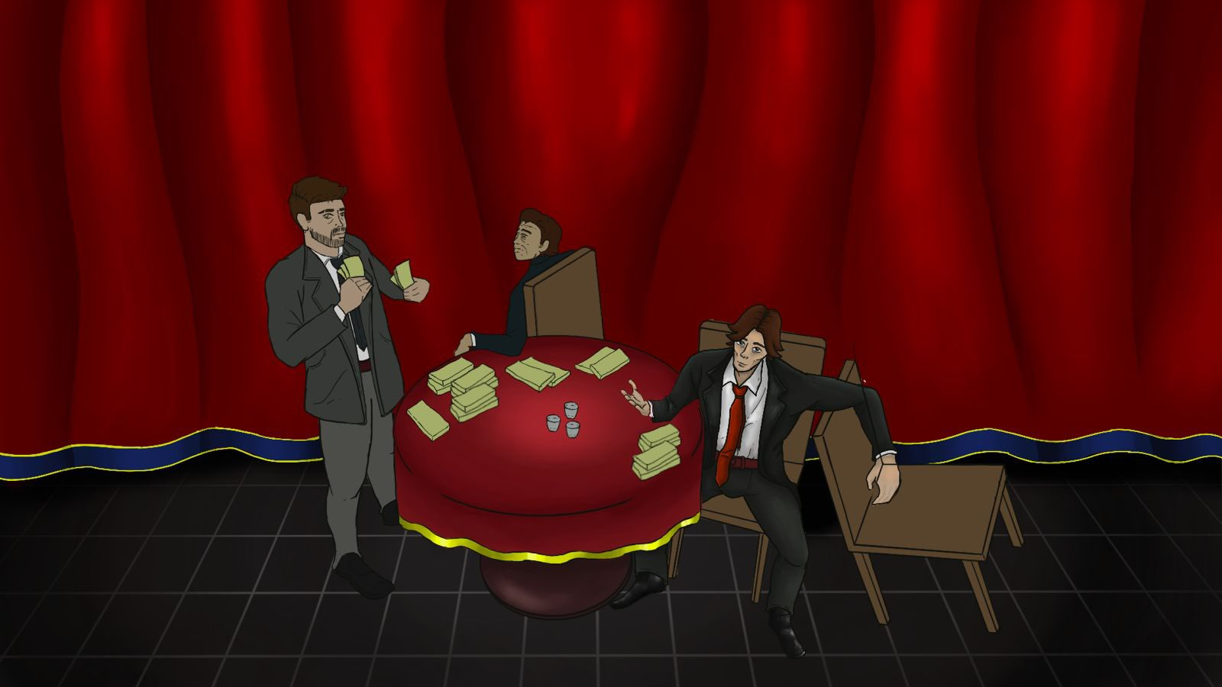
At the end of that life Crossroads
To deliver a game prototype with storytelling driving the main gameplay.
Notes:
My team and I will deliver a game prototype with the story driving the main gameplay.

Slide 2
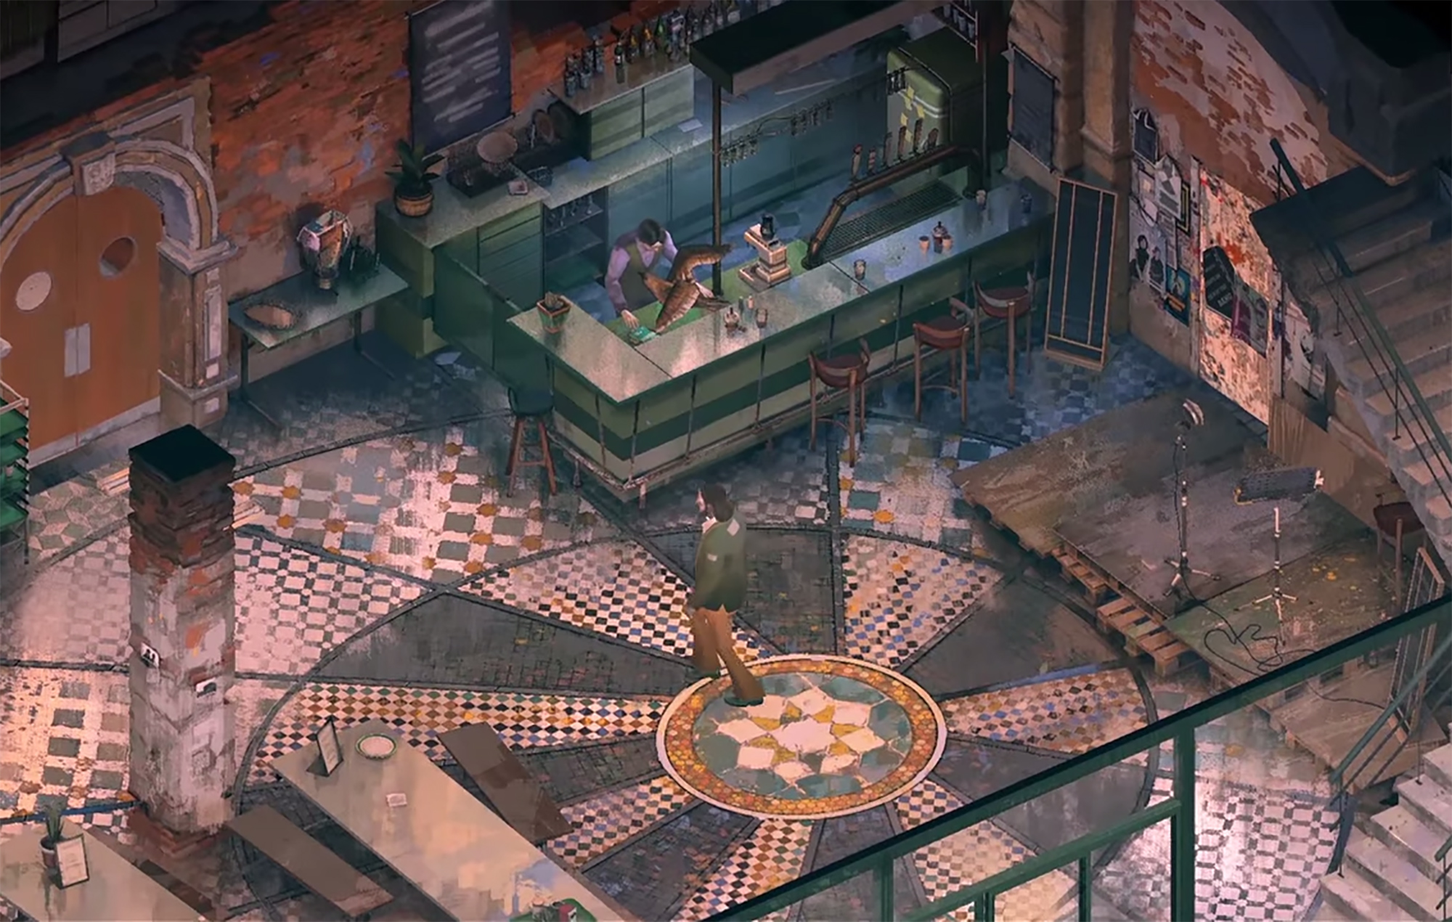
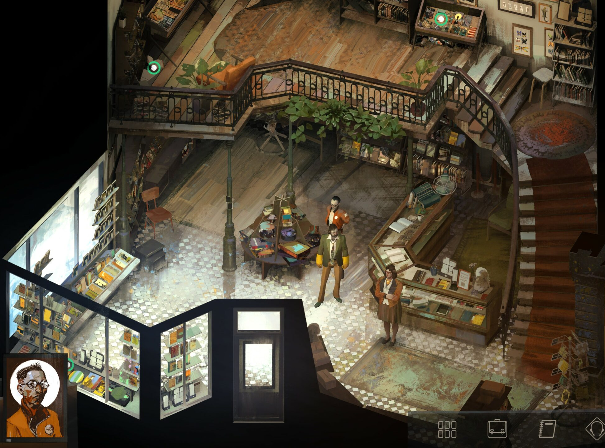
Art-style/ Gameplay will be similar to
Disco Elysium and What remains of Edith Finch
Notes:
The game will have a top down, isometric view which is like to Disco Elysium. Since we are trying to tell a story, the game mechanics will be based on the story and it will be mostly linear. The gameplay is inspired from “What remains of Edith Finch” and is very narrative driven having effortless, easy and yet unique puzzles.
I’ve always liked prototyping games. Since this is my hons year project, I wanted to work on something more challenging and this project is a more ambitious that the other games I’ve worked on. It will be helpful to have it on my portfolio as I want to start my own Studio. This will showcase my design and development skills as well as being the team lead will show my project management.

Slide 3
To explore the interplay between narrative and game design and how to shape game design around a narrative by the creation of “narrative puzzles”.
OBJECTIVES
1 | Research about choices and narrative in games by reading books on game design and watching GDC talks of other games which have done it or tried to before and where they’ve failed/ succeeded.
2 | Explore other games which are driven by narrative rather than by puzzles and identify how they have done it.
3 | Identify the main events in the narrative of my game and whether the player can progress in the story without completing the puzzles or is forced to solve it before they can proceed and do more exploration.
4 | Work on different gameplay elements in the engine such as dialogue system, movement, ai and more.
5 | Prototype a game with all these elements of game design and narrative design to give the player a fun and immersive experience.
Notes:
The aim for my research is To explore the interplay between narrative and game design and how to shape game design around a narrative by the creation of “narrative puzzles”.
To achieve this aim, I’ve broken it down into the following objectives.
Reading books on game design and watching GDC talks by developers and designers about choices and narrative games.
Exploring other games which are narrative driven rather than by puzzles and breakdown their gameplay to what works and not.
Identifying main events in the narrative of my game and deciding how to go about game progression.
Working in engine on different systems that make the game like dialogue, ai and movement.
Making a prototype to convey the story in a fun and immersive way.

Slide 4
Notes:
This is our WIP

